Slide 1
CMPT 436 PROJECT
Comparing SOAP and REST

Slide 2
Applications:
Chatroom build using REST.
Chatroom build using SOAP.

Slide 3
Experiments:
Measuring response times in different scenarios.
Increasing data volumes.
Increasing concurrency and number of requests.
Increasing both data volumes and concurrency.
Testing response times of key methods createRoom(), getMsg, sendMsg() of both our apps.
We will also look into other aspects like Failure handling, Scalability, Security.

Slide 4
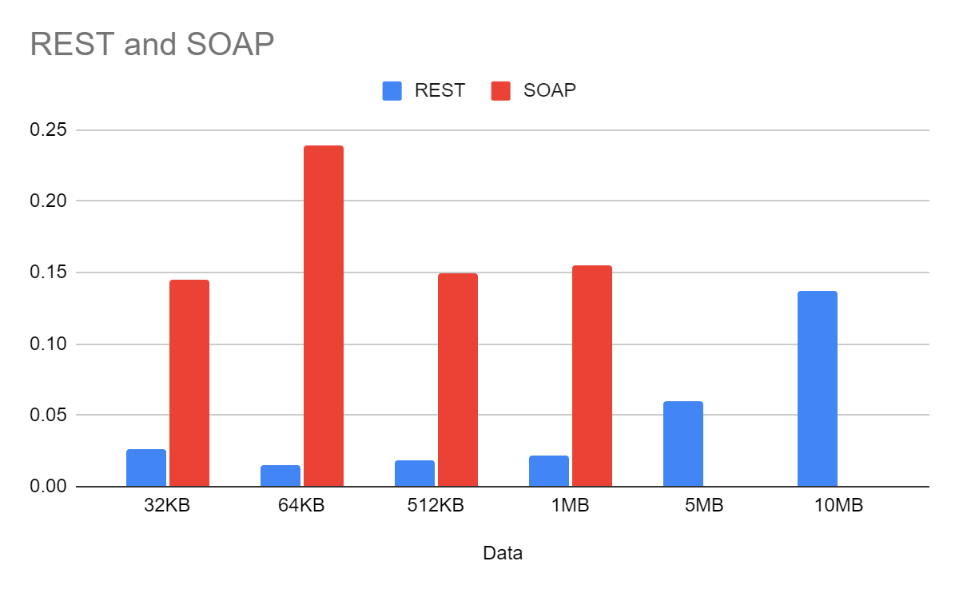
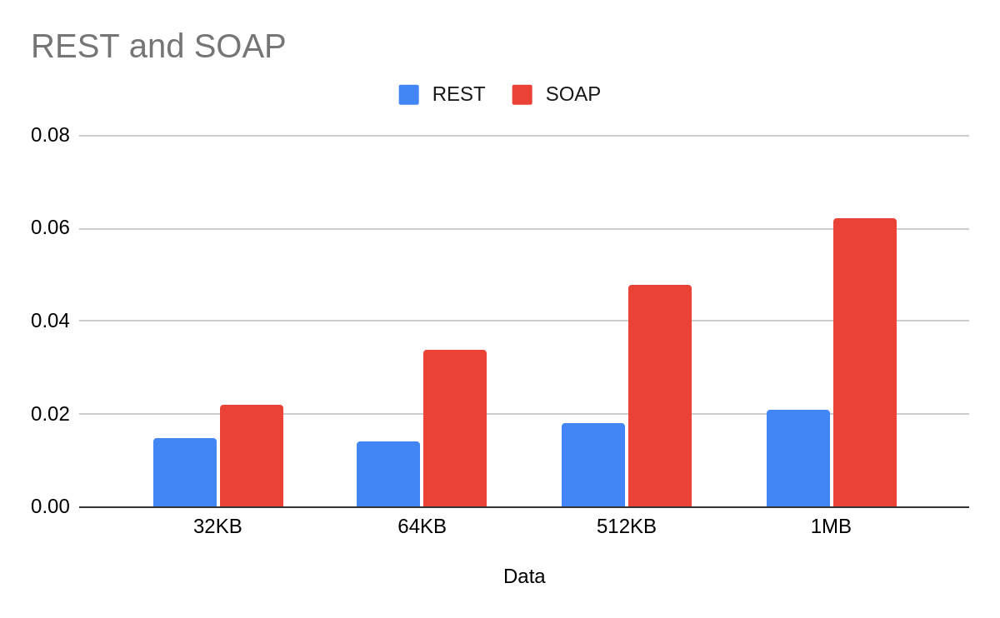
Results:
Response times:
Testing apps with large volumes of data.
POST GET

Slide 5
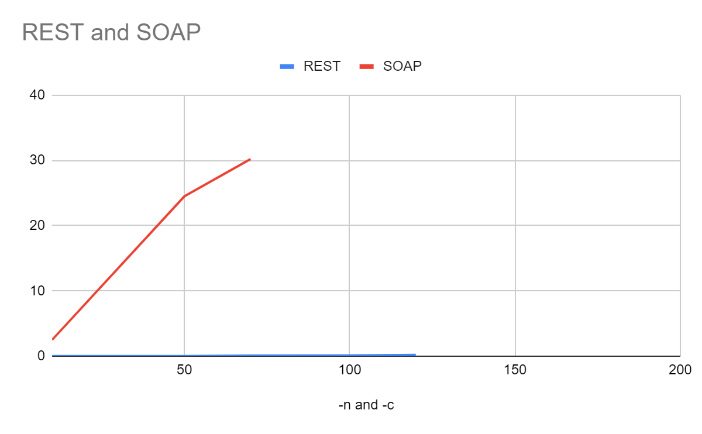
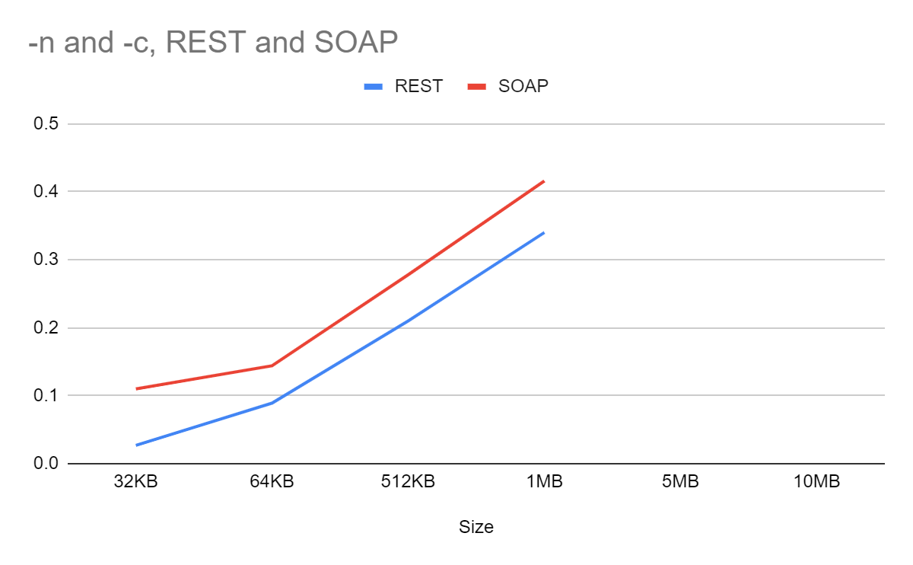
Testing with multiple clients:
With First load Penalty Eliminating First load Penalty

Slide 6
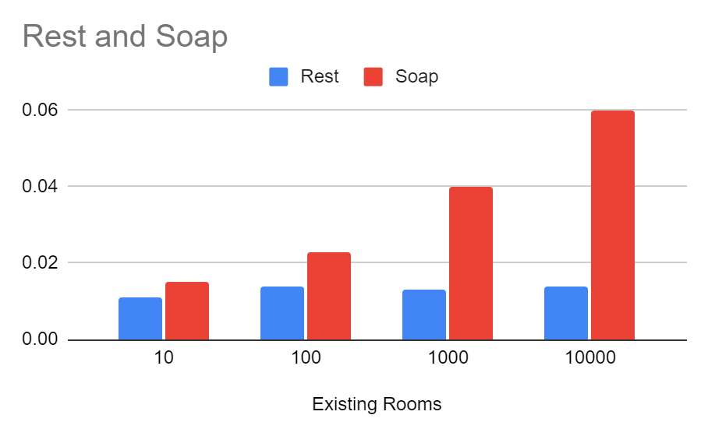
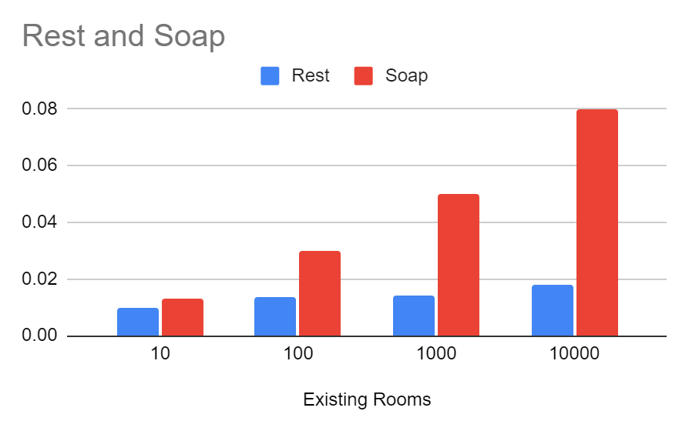
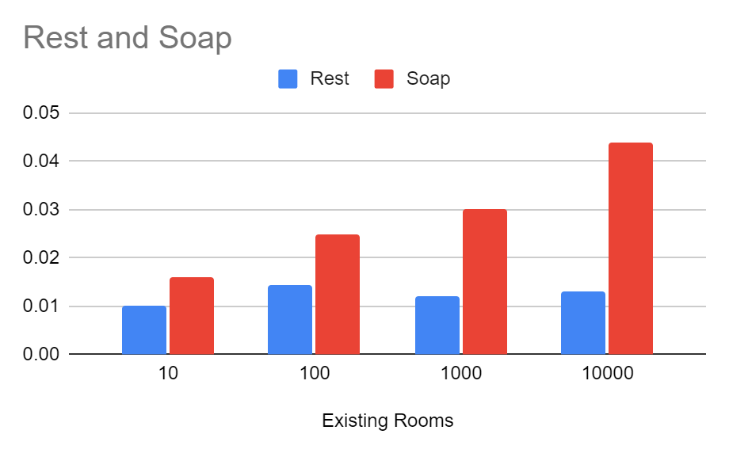
Testing key methods of our Apps with many chat-rooms
createRoom sendMsg getMsg

Slide 7
Comparing other important factors:
Failure handling: SOAP has an in-build retry mechanism.
Scalability: Both are scalable.
Security: Both SOAP and REST can use SSL or Secured Socket Layer for protecting the data during the API call request but Soap has better security as it also uses Web Service-Security.

Slide 8
Conclusion:
In our use case REST clearly seems to be the better choice due to its lightweight nature and quick response times. Hence REST is a good choice for web browsing, social media, chat apps
SOAP seems to fit better in use cases where security is of utmost importance such as Financial, Payment Gateways, Telecommunication.

